Slide 1


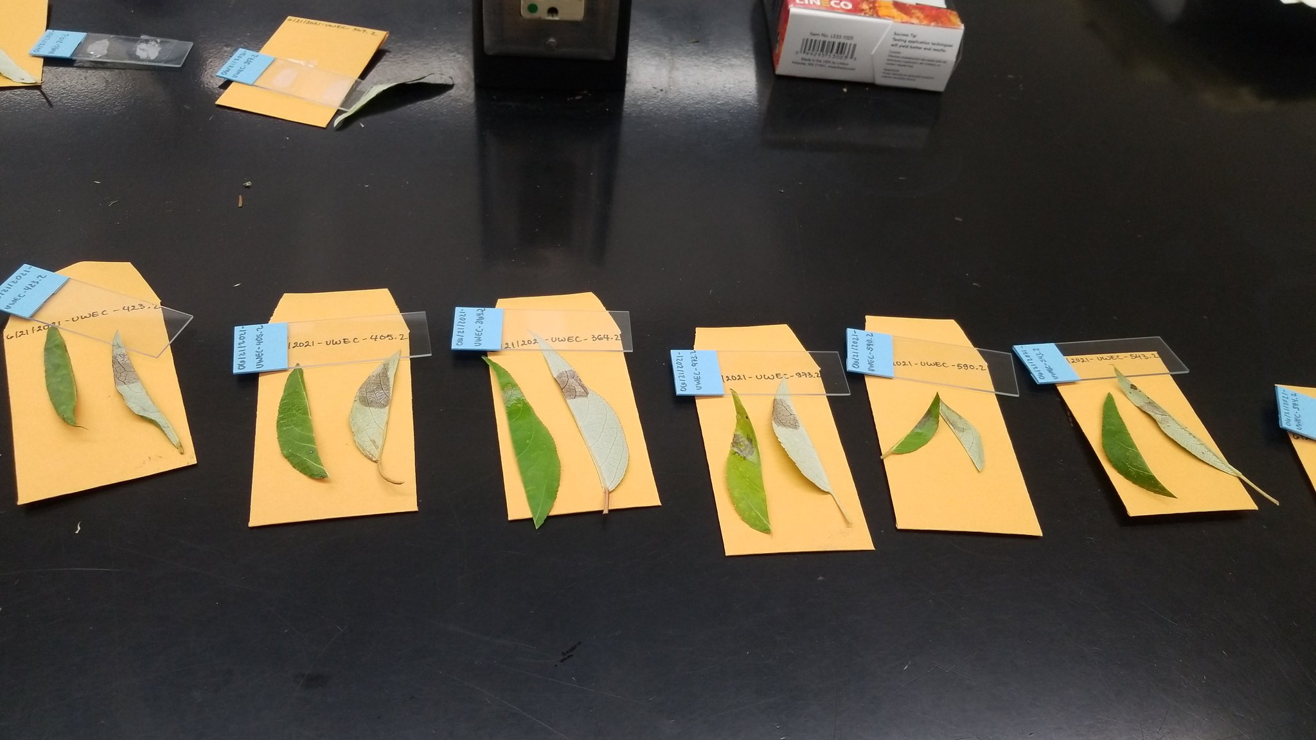
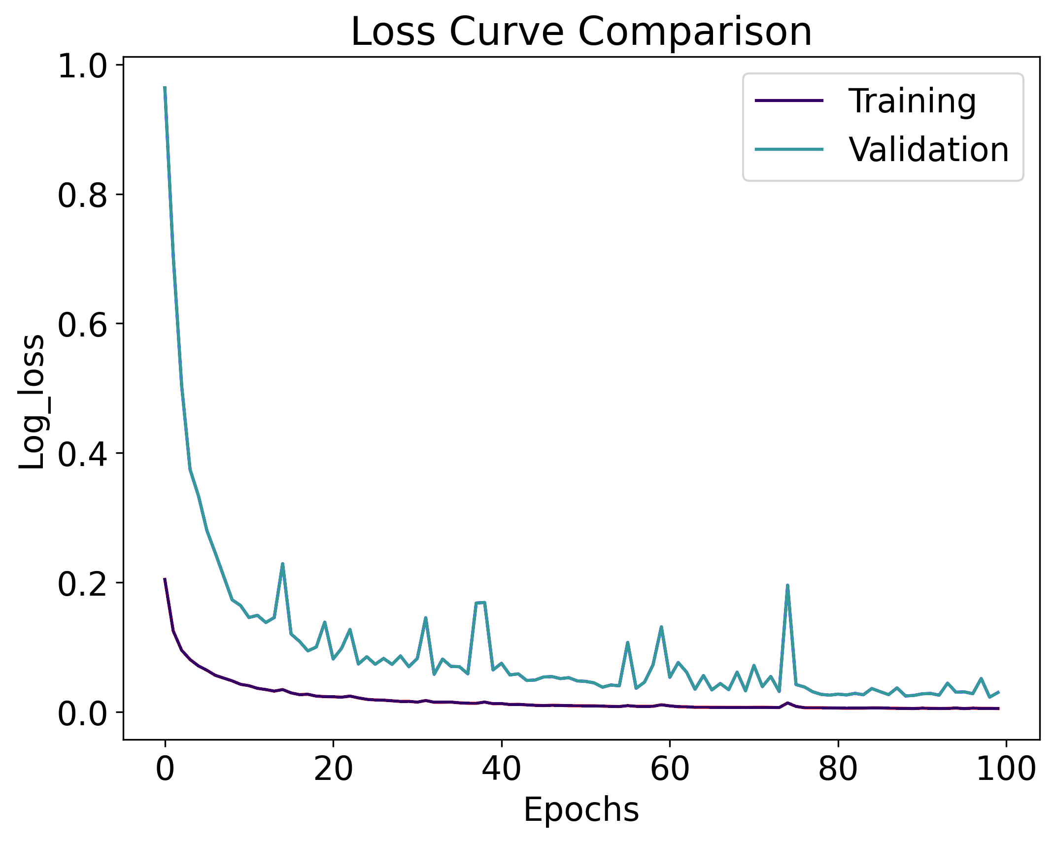
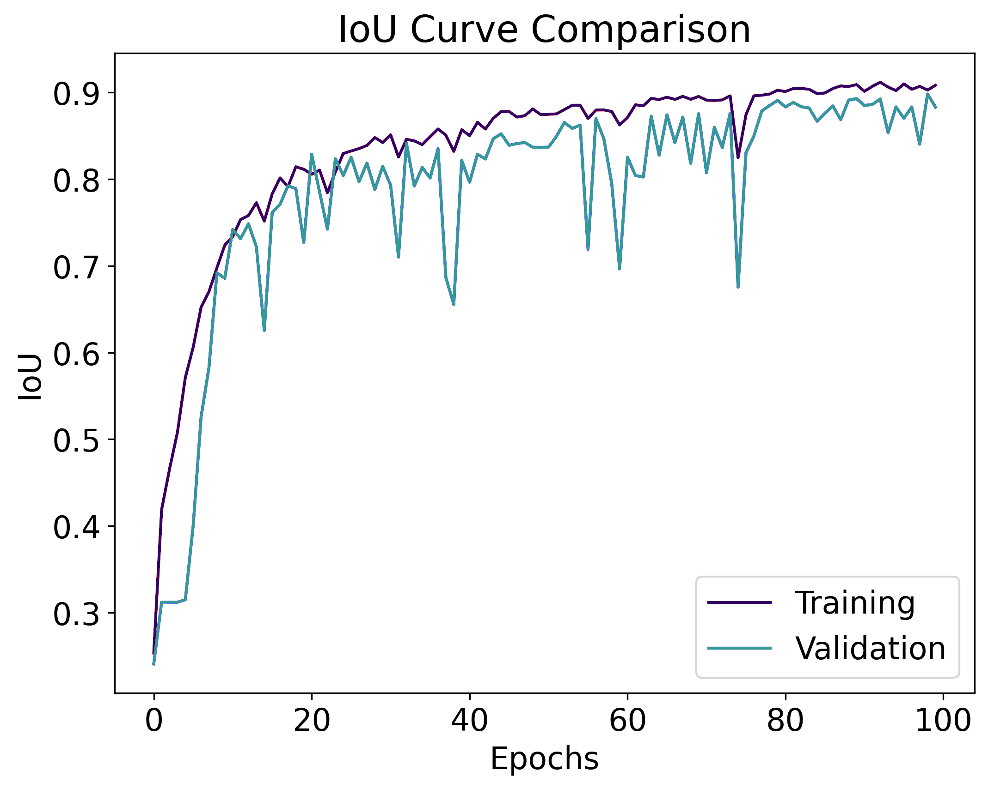
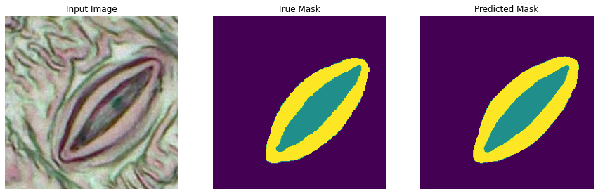
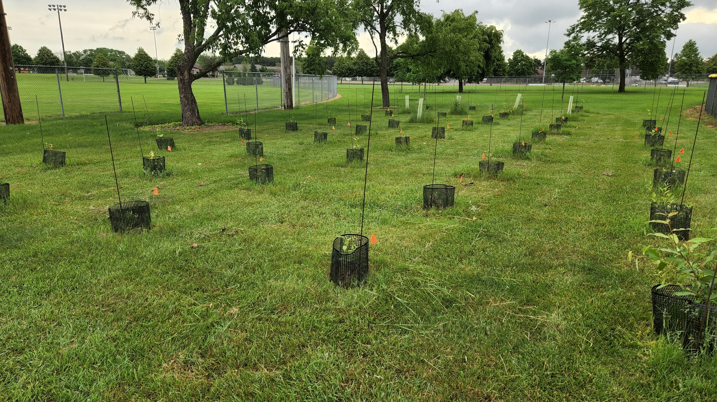
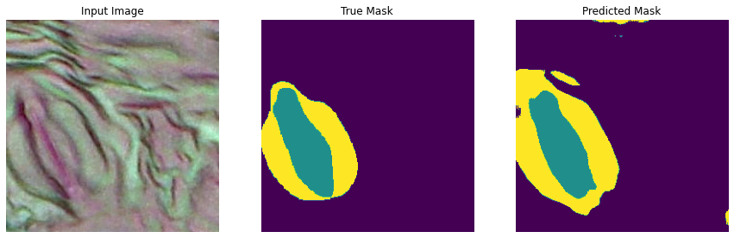
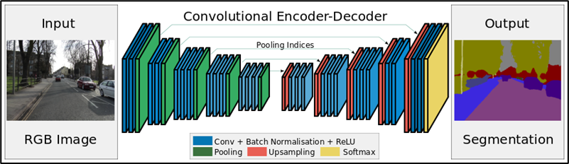
A Deep Learning Approach to Automate the Analysis and Prediction of Function for Poplar Stomata
Dataset for training
Dataset size, dimensions, training, validation, segmentation done using etc.
A dataset of 140 (1600px by 1200px) RGB images of stomatal impressions were collected. To train the deep learning model, manual segmentation masks were created with one color corresponding to each part of the image: pore, guard, or background. For preliminary results only 12 images were masked and used for training as this is a highly time consuming task.
Segmentation masks were done using two different open source graphics editors: paint.net (Windows) and GIMP (Mac). Each region of interest was outlined by hand and marked with the proper color.
Include portion on incorrect masking and the fix?
While training, images must be a manageable size. Each image and mask was sliced into 256px by 256px images with 50% overlap. This produced 108 images for each original image and mask producing a 1296 images and 1296 masks, each of size 256px by 256px.
The dataset was then split for training into 80% for training and 20% for testing.
Connor McKeown, Philip Gillett, Katherine E. McCallum, Dr. Nora Mitchell, Dr. Rahul Gomes
Department of Computer Science; Department of Biology
Results
Introduction
Pore | 0.9933
Background | 0.8990
Guard | 0.7861
Table 1. Jaccard score comparison between true masks and predicted masks. A score closer to one indicates a higher similarity.
Stomatal Functioning
Understanding the changes in climate across large regions is necessary to understand how plants adapt to different conditions. The characteristics of plant stomata, which are small pores whose main function is regulating water loss and gas exchange, tell us important information about how plants respond to their environment. Poplars are an emerging model system for studying adaptation to climate change, including stomatal functioning.¹ Previously, biologists gathered information about stomata by individually measuring microscope images by hand.
Table 2. Accuracy, Loss and Mean IoU data. Accuracy is a biased metric when doing a segmentation problem and produces a high value, hence the use of the Jaccard score in Table 1.
Figure 2. Setup for taking stomatal leaf impressions from poplar samples using New Skin adhesive bandage.
 | Training | Validation
Accuracy | 0.9932 | 0.9889
Loss | 0.0054 | 0.0303
Mean IoU | 0.9082 | 0.8831
Experimental set-up
Materials and Methods
Tensorflow library used, GPU used on Colab, loss function, dynamic image augmentation and types of augmentation, learning rate, optimizer etc.
Dataset for training
Automated Morphometry
A dataset of 140 (1600px by 1200px) RGB images of stomatal impressions were collected. To train the deep learning model, manual segmentation masks were created with one color corresponding to each part of the image: pore, guard, or background. For preliminary results only 12 images were masked and used for training as this is a highly time-consuming task. Segmentation masks were done using two different open-source graphics editors: paint.net (Windows) and GIMP (Mac). Each region of interest was outlined by hand and marked with the proper color.
While training, images must be a manageable size. Each image and mask was sliced into 256px-by-256px images with 50% overlap. This produced 108 images for each original image and mask producing a 1296 images and 1296 masks, each of size 256px by 256px. The dataset was read into a NumPy array and split for training into 80% for training and 20% for testing.
Deep Learning Algorithm
Manual morphometry has some significant limitations, most notably the lengthy amount of time it takes and inconsistent accuracy. Automated Morphometry aims to use deep learning to provide fast and accurate morphometry. Stomata images are represented as a 2D matrix of values, that represent either the pore, guard cell, or a value that is neither. From here, the numbers of pixels under each value is computed, and then the data on height, width, and area of each stoma is calculated.²
All about U-Net, encoder, decoder, number of layers, number of parameters, etc.
Figure 4. The loss comparison represents how bad a model’s prediction is. A downward trend represents a model that is learning.
Figure 5. The intersection over union comparison between measures the accuracy of predicted segmentation masks.
Project Goals
Figure 7. An example of an exemplary mask prediction.
In our study, we sought to automate the collection of stomata data using machine learning to optimize this process and make it more repeatable.
Experimental set-up
Tensorflow, Keras, and Scikit learn were used for building the U-Net model and analysis of results. The preliminary model was trained using Google Colab free GPU resources. In order to provide variation in input data, images were randomly augmented and cropped. While maintaining it’s data, this allows for the model to artificially see a larger variety in the original dataset.
Figure 8. An example of an imperfect predicted mask.
Deep Learning Algorithm
A U-Net model with five encoding and five decoding layers trained for 100 epochs was implemented. A kernel size of 3x3, dropouts of .07 and max pooling were applied. The optimizer used was Adam and the loss function was sparse categorical cross entropy. With segmentation, accuracy values are typically high due to lots of correctly predicted background space. To represent the accuracy of our model we use the IoU value to give a better indication of the predictions
Conclusions and Future Work
Major conclusions plus future directions, bring it back out to BIG PICTURE, see the ORSP proposal
You can also talk about object detection
^we plan to test additional parameter modifications?
We plan to use our work to help study the actual gas exchange of the stomata on the physiological level. Our U-Net model will help us efficiently process data for future and more complex stomatal analysis.
Figure 1. Poplar common garden in Eau Claire, Wisconsin, containing two blocks of 47 different Populus trichocarpa / P. balsamifera genotypes collected across Canada and Alaska.
Biological Samples
One leaf per plant was harvested in July 2022 and stomatal impressions were taken using New Skin adhesive bandage and lifted off the leaf with tape. Raw images of each imprint were taken using a compound light microscope at 40× magnification in two haphazardly chosen areas of 0.069mm² each.
References
1. McKown, Athena D., et al. "Association genetics, geography and ecophysiology link stomatal patterning in Populus trichocarpa with carbon gain and disease resistance trade‐offs." Molecular ecology 23.23 (2014): 5771-5790.
2. Gibbs, Jonathon A., et al. "A Deep Learning Method for Fully Automatic Stomatal Morphometry and Maximal Conductance Estimation." Frontiers in Plant Science 12 (2021): 780180.
3. Badrinarayanan, Vijay, Ankur Handa, and Roberto Cipolla. "Segnet: A deep convolutional encoder-decoder architecture for robust semantic pixel-wise labelling." arXiv preprint arXiv:1505.07293 (2015).
Figure 3. Visual representation of how Semantic Segmentation using U-Net architecture is done using Deep Learning. Image adapted from [3]
We thank the Office of Research and sponsored Programs for supporting this research and Learning & Technology Services for printing this poster.

